Slide 1
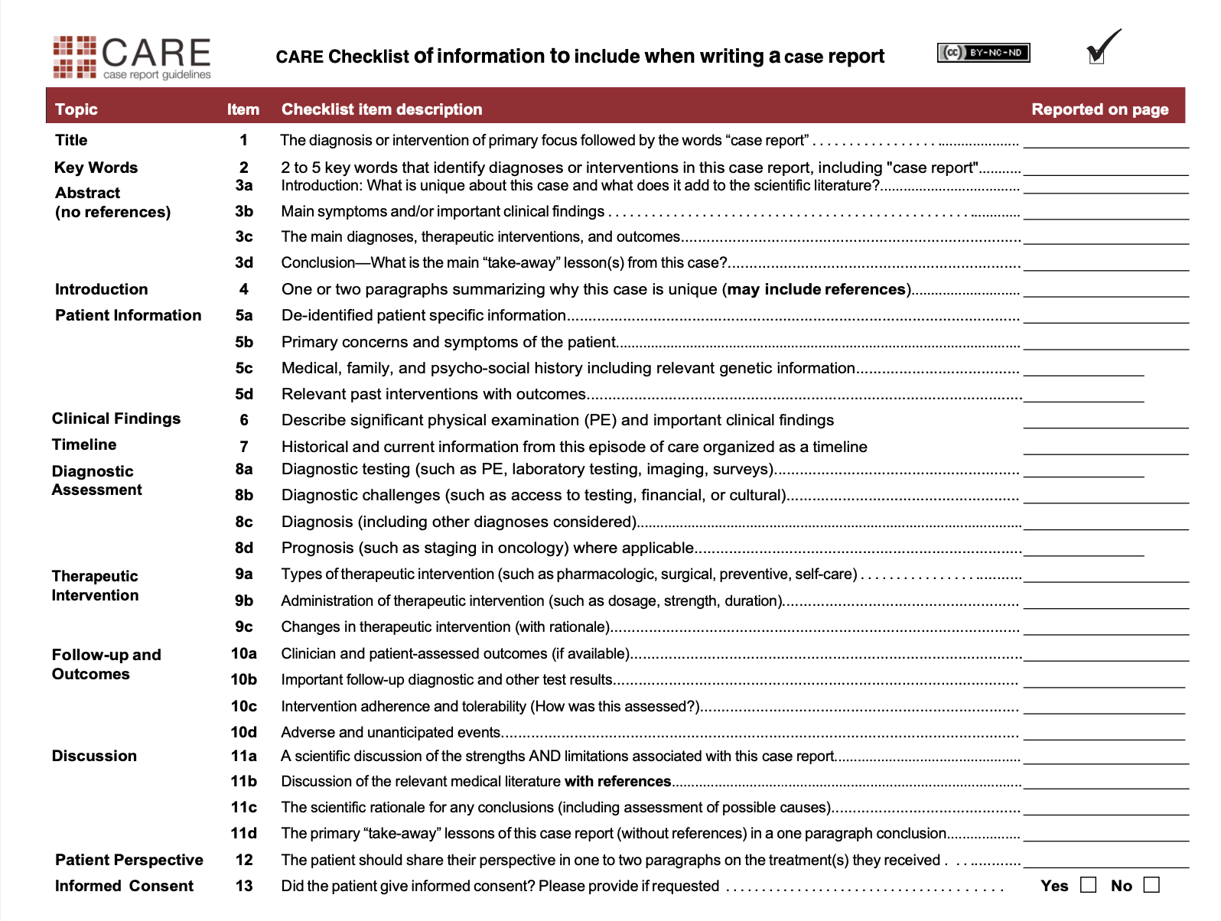
1
1
1
1 and 2
2,3,4
7
1
Yes
1 and 2
2
2
2
2
2
N/a
2
2
4
4
4
1 and 2
4
4
N/a
5,6,7
8 and 9
5,6,7
7 and 8
N/a

