Slide 1
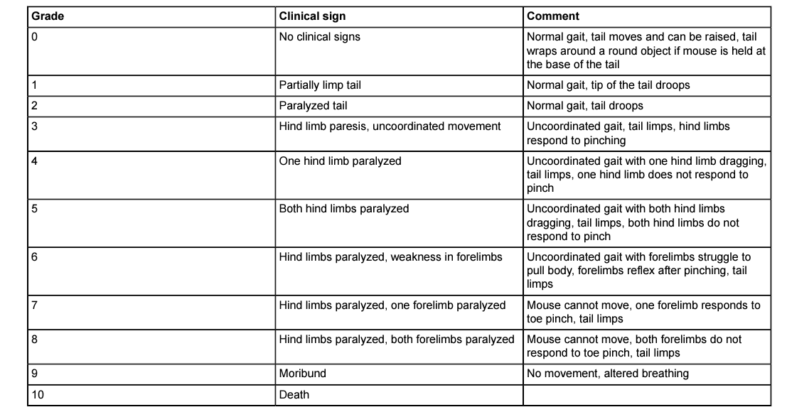
Supplementary table 1: Clinical score symptoms after EAE model induction. Taken from Bittner et al., 2014. doi:10.3791/51275

